Slide 1


Albania Cultural Webinar

Slide 2
Introductions/background to project
MSOICU
Guest speakers:
Professor Stephanie Schwandner-Sievers - Bournemouth University
Howard Lycett - North West ROCU
Dr Anta Brachou - St Mary’s University
Irena Kraja - Mary Ward Loreto Foundation in Albania
Reasoning behind the project
Methodology
Handouts

Slide 3
Reflection: Media references and narrative of the Albanian culture

Slide 4
Albanian historical background
Occupied over 500 years by the Ottomans, Albanians used as slaves.
Balkans War 1912-13 and independence
45 years of rigid Communism (1946-1991) – totalitarianism, strong hierarchical and gender structures
Civil war, collapse of the pyramid scheme
Kosovo conflict, (1998–99) conflict - ethnic Albanians opposed ethnic Serbs and the government of Yugoslavia
Issus of class post Communism – those that have money, education have more opportunities
Youth culture - desire to be part of global culture – social media influence
Radical changes in last decades; totalitarianism to more liberalism.
Mass migration as a lifeline
Albanians in neighbouring states – Macedonia, Montenegro, Kosovo etc. Need to not stereotype and be aware cultural differences may well exist within Albanian culture
TIP: Avoid stereotyping and be aware cultural differences may well exist within Albanian culture

Slide 5
Greetings
Being able to speak a few phrases will support initial engagement and show and interest in the culture.
Handshake, look in the eye, respect is very important
Mr and Mrs can be used as a sign of respect
Make at ease, be welcoming – low tables, comfortable chairs
Offer coffee! – Coffee culture
Explain your role, could be used to harsh treatment from law enforcement
Will need reassurance of a safe environment, information on rights and support
Take note of body language – signs of being uncomfortable
Asking about family members, can be a buffer to more formal questioning
Can be very expressive, loud, sometimes viewed as aggressive
TIP: Shqipe refers to the eagle can be used to acknowledge that you know they are Albanian. Positioning your hands in the form of a bird/eagle to signify its importance and tune into the national pride in their flag can be a useful ice breaker if it is known they have nationalist pride.
Notes:
(Simona? for pronunciation)

Slide 6
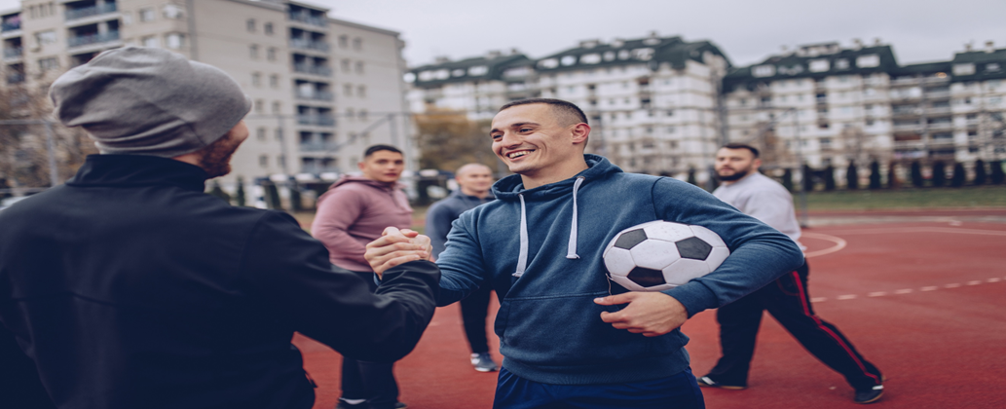
Greetings continued
Mire se erdhe - welcome (when someone comes to meet you, or arrives in your office/place)
Pershendetje, si jeni? – Hello, how are you? (pronounced per-SHEN-det-ye si jeni)
Ç'kemi, si je? – Hi, how are you? / What’s up? (more informal/younger generation)
Miremengjes – Good morning, miredita – good day, mirembrema – good evening
Mirupafshim – Goodbye (pronounced meer-uh-pAh-fsheem)
Mos ke/keni merak – Do not be worried/don’t worry
Si e ke emrin? – What is your name?
Sa vjec jeni? – How old are you?
Jemi ketu per t’ju ndihmuar – We are here to help you

Slide 7
Key cultural elements
Language –one of the oldest Indo-European languages still in use. 2 dialects: Gheg (North), Tosk (South).
Hard working, very resilient, endured hardship through Ottoman Empire and Communism.
Importance for men to show wealth accumulated – car washing link.
Anxiety around social status, respect on a global scale, rejected from wider society. Link to crime and rejection of an asylum claim.
Respect for elders and family, male roles dominate.
Food and music, very generous hosts – saying “bread and salt is all I have , but I give it to you with a light heart”.
Strong sense of pride but also inherited parts of neighbouring cultures – Turkish, Greek.
Code of Besa/honour. Comparison to ‘omerta’ – mafia term meaning code of silence, refusal to give evidence to the police.
Emphasis on community over individual life but fragmented diaspora in the UK.
National hero’s – Mother Theresa, Skanderbeg, Dua Lipa, Rita Ora

Slide 8
Main reasons for migration
Economic – Poverty, taking care of family, necessary sacrifice.
Education and work opportunities, high-level work ethic whether industry or criminal activity – put back into businesses/family.
To escape corruption
To live more freely – LGBTQ+ for example
Sending money back home, invest in the country. Brain drain scenario
Often 2nd oldest migrates, oldest stays to take care of older generations.
Blood feuds or Gjakmarra/Gjaku - in North and rural areas, a risk factor if need to return. Hakmarra –has been resolved.
Opportunity to gain status and wealth, need for signs of success
To escape gang involvement or law enforcement.
Shame and rejection if shunned by indigenous population, heighten vulnerabilities – asylum seekers.
Unsuccessful returning migrants - stigmatised. Those that are successful in Albania – ‘you made it’ due to corruption.
Struggle with the thought of migrating - national pride and leaving their traditions.
Most migrating to earn money not to enter crime, but unmet expectations, reality hits. IMA is also now having an impact.

Slide 9
Taboo’s/ prejudices
Sexual exploitation – female officers, belief that men will judge/not believe. Shame for family. Talk of intimate body parts, sexual jokes.
Dishonour – women having multiple partners, sex working, cheating, stealing another’s wife.
Divorce.
Crimes - drug dealing acceptable, sometimes glorified. Stealing shameful – Kanun references
Term ‘victim’ of abuse - stigmatisation, anonymity, women – duped, stupidity if exploited. Men - weakness, being misled.
LGBTQ+ - ‘shameful’, but laws being introduced, becoming more inclusive
Mental health issues, physical disabilities.
Racism – links to Communism, isolation. Some prejudice towards Roma, Southern Greeks and Serbs. Northern Greeks, Kosovans and Macedonians – ‘larger Albania’.
Past taboo - to leave parents alone, must be taken care of, still expected to look after their welfare.
To be poor – pull to migrate, to make money, better themselves.
Notes:
Explain video is (17 mins long with ads) to watch in own time
Simona to discuss W.Mids case of mistake made on comms when describing Roma man convicted rather than Romanian. Also in video – looking to ban the term Roma as too similar to Romanian.

Slide 10
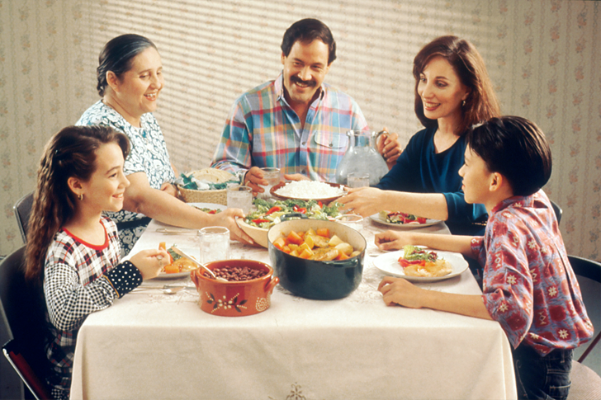
Family structure/gender dynamics
Importance - taking care of family, embedded within besa, pride, strong family ties, lack of welfare system.
Strong gender roles. Men as providers, decision-makers. Females as home makers, more submissive. Gain status if produce sons. Urban areas more progressive, now being seen in powerful roles, inequality still exists.
Lack of interest on where family income has come from – crime proceeds.
Marriage usually within own region and religion. Traditional societies - arranged marriages.
(case study of nusja abuse)
Difference in gender friendship groups.
Role names – Nusja = bride, Xhaxha = uncle, Mërgim: life abroad as an emigrant, can also mean exile or Kurbet: living elsewhere as a foreigner.
Children – pride if succeed, boys inherit.
Extended, large families. Shared household and pool of resources. Urban areas more nuclear structure.
North and South different customs, North – Kanun law.
Rural more traditional, urban more forgiving, modern views.
Tip: Street culture on the increase – divorce, family breakdown, migration, gangs may replace family. Besa reinvigorated to create trust. Look after your ‘miqtë’ or friends.
Notes:
Roma may refer to aunt uncle or husband wife but not be actually married or a true connection
*Lia – to come in with how perpetrators can use the term ‘wife’ as a means of control, victim will think they care. use of term ‘boys’ to refer to children in general.
**Simona case examples highlighting differences and of Roma marriages, to talk about cases in B’ham during pregnancy team of Roma marrying young and of 27 year old with 7 children, illiterate, signed name with ‘X’, power of God that they were pregnant

Slide 11
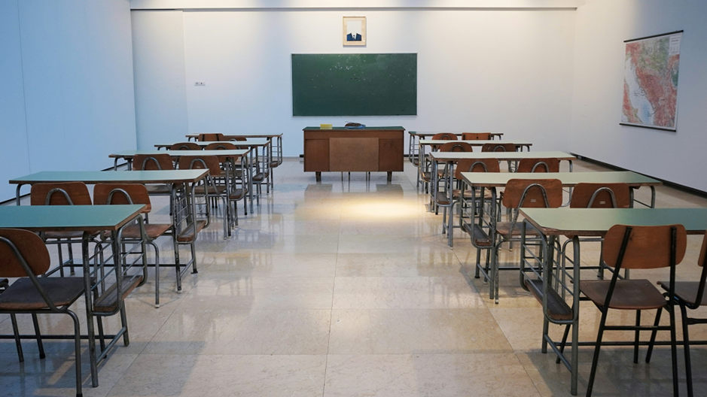
Issues related to Education
Urban vs. Rural Dynamics
Urban Areas:
More diverse career opportunities.
More opportunities for women/girls to pursue education.
Rural Areas:
Emphasis on working the land.
Gender roles more traditional.
Impact of Traditional Gender Roles
Men often decide who attends school.
Approval of career choices for children.
Physically developed girls may be prevented from attending school.
Early marriage is common (in rural areas).
Instant Gratification vs. Long-Term Success
Wealth as a Measure of Success
Parental Pressure
Often prioritise sons
Migration encouraged if children do not excel
Limited Opportunities and Lack of Motivation/Support
Education as a class issue
High dropout rates due to migration, lack of support, bullying and social media influence.
Need for Systemic Changes
Support for those with learning difficulties
Issues of bullying and social education.

Slide 12
Religion and festivals
Important Religious Dates:
Ramadan / Eidh
22nd March - Sultan Novruz:
Bektashi feast, commemorates cousin of
the Prophet Mohammed.
Catholic Easter: Usually in March or April.
Orthodox Easter: Usually April or early May
Other Feast Days:
8th March - Women's Day
14th March - Dita e Veres (Summer Day):
1st May - International Workers Day:
5th September - Saint Theresa Canonisation Day
28th and 29th November - Independence Day and Liberation Day
8th December - National Youth Day
Main religions
Muslim (majority) - Ottoman influence
Bektashi
Orthodox
Catholic
Religious Landscape
Statement rather than practicing, but rare not to believe in God.
Cities are more mixed in religious beliefs.
Generally, extremely tolerant to varying religious views, although some judgment on strict Muslims.
Different religious groups live harmoniously, all main holidays celebrated.
Notes:
Avoid scheduling of interviews for investigations around the most important festivals for Romanians and Roma – Easter and Xmas especially.

Slide 13
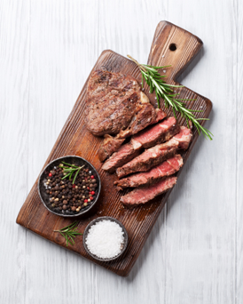
Food
Very important, getting together, social culture, demonstrating besa and hospitality.
Abundance of food at a gathering as a success, pride, routes to Communist past.
Traditional meat and potato, beans, cabbage in stews, bread, cheese.
Majority Muslim - surge of restaurants serving halal meat.
Similar to Greek, Turkish and Italian cuisines – Mediterranean focus.
Rich food – veal, lamb especially at celebrations (rump to very important guests, shoulder or head to next important, legs to children)
Dollma (stuffed vine leaves)
Hashure (sweet fermented grains)
Ballokume (sweet cookie eaten at Spring festival)
Sheqerpare (shortbread soaked in sugar syrup)
Baklava (layered pastry with nuts and syrup)
Raki (strong alcoholic spirit made from grapes)
Albanians can be unaccustomed to Western European food and the spice of Asian and African cuisines.
TIP: Allow time for a coffee and a cigarette to build rapport and engagement.
Notes:
,non-Roma who do not have these same views around food can be considered ‘unclean’ and food will not be shared or eaten in close proximity for fear of being ‘polluted. (Council of Europe).

Slide 14

Interaction with authority
Lack of trust in State - Communist routes, will have ‘guard’ up, need to build bridges, still considerable poverty.
Lack of trust in Police – will assume account not believed, offer another. Fear being judged, punishment and consequences, threats against family.
Go slow, look to build trust first, prior to intense questioning.
Corruption improving, still believe money can buy everything, justice included – relative in the police, certain advantages.
Being given forms that do not understand - heighten anxiety, intimidation fears. Used to receiving limited information about rights, support and being kept informed.
Difficulty expressing themselves - anxiety and mistrust issues.
Sexual crimes – dishonour. Criminal exploitation – more acceptable or normalised, providing for family, sentences not a deterrent, not being labelled as a ‘grass’.
More open to religious authorities, positive role in COVID
Media – mixed views, sometimes assist, sometimes misinterpret
Academia viewed with respect
Wider community – reliance on Albanian communities in UK, still somewhat guarded.
Family trusted the most, more important as lack of state support.
Notes:
Simona to discuss how police turning up at your door will be seen as a sign that you have done something wrong – shameful, leads to gossip.
Lia to expand on NGOs and need to be specific about what the NGOs could do, what we mean by assistance as not used to help and could be mistrust. Case study of woman with her baby that did not have a birth certificate and need to meet their immediate needs to ensure more active engagement.

Slide 15
Do’s & Don’ts
Do’s | Don’ts
Advise there to listen and assist where you can, be consistent and reliable. | Use the term victim, prostitution – shame attached, not understood
Be approachable and polite – although are often surprised by the latter! | Be intimidating – will increase embedded anxiety, more informal conversations may make for more open discussion
Be victim-centred and trauma-informed | Provide judgement, stigmatise or generalise
Look to build trust, advise on rights and support available – use specialist NGOs | Discuss gangs – this will most likely be met with an extreme lack of engagement
Ask them to show you where they live on a map – avoid boundary confusion, avoid reference to Macedonia, Kosovo etc | Use phrases such as “are you sure?” or “did you not understand what was happening” or others that might infer you do not believe them.
Consider the wider context – for example, rejection of asylum, impact of having nothing to lose, stigma or shame they may have. | Go overboard with empathy, Albanians may not understand this, as they may not consider themselves to be victims or be used to this behaviour.
Notes:
Patience - LIA @ IJM to talk about how Roma/Romanian (check if both) may not be used to be asked how they are, or emotional things that have happened to them, so the importance to take your time at the start.
Simona to discuss interpreters when looking out for potential learning difficulties – victim will say born when the flowers come out, but interpreter will say Springtime – case of female begging.
Stereotype – Simona to expand on this and mention how on patrol used to hear ‘Romanian looking male/female seen…’ but can have blond blue eyed or dark hair and eyes…
Lia to give more information on address details – tracking cases when have a warrant

Slide 16
Thank you for listening Q&A Session

